Slide 1
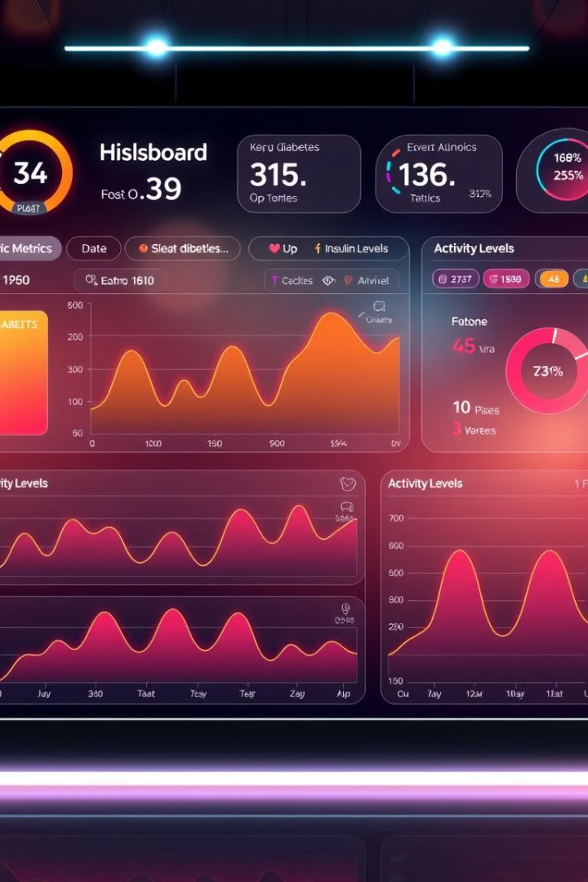
Diabetes Prediction System
Welcome to our comprehensive presentation on the Diabetes Prediction System, a cutting-edge solution leveraging machine learning to revolutionize the early detection and management of this widespread health condition.

Slide 2
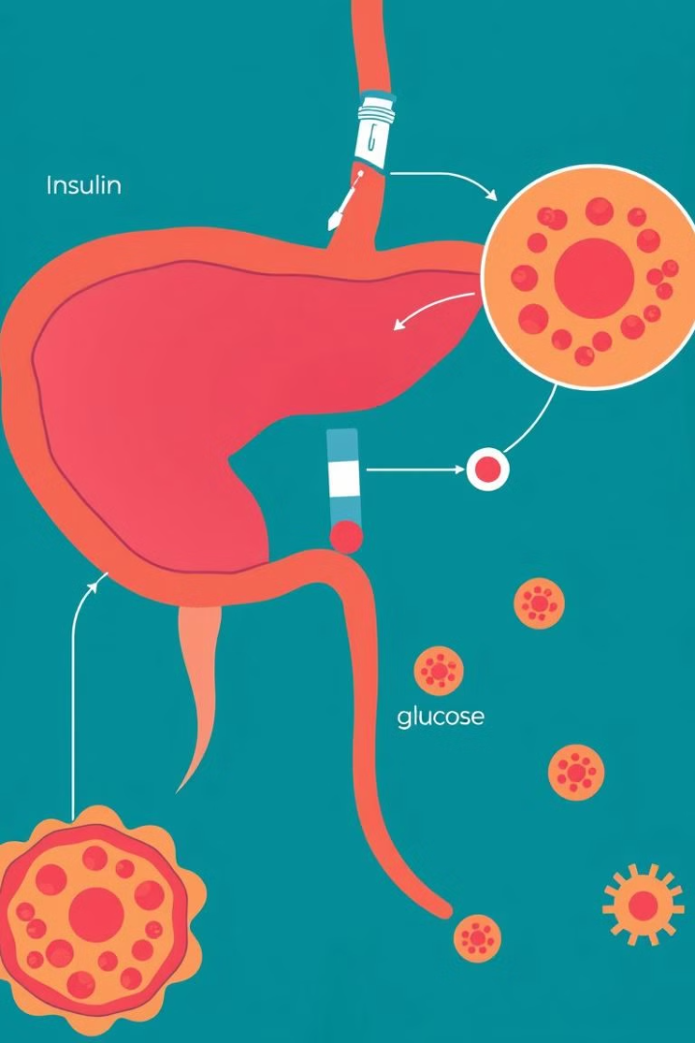
Introduction to Diabetes
What is Diabetes?
Prevalence and Impacts
Diabetes is a chronic condition characterized by the body's inability to regulate blood sugar levels effectively.
Diabetes affects millions worldwide, with serious health complications if left unmanaged.
Early Detection is Key
Timely diagnosis and intervention can greatly improve patient outcomes and quality of life.

Slide 3
Machine Learning Approach
Data-Driven Insights
Predictive Modeling
Personalized Recommendations
Our system leverages advanced machine learning algorithms to extract meaningful insights from large datasets.
By analyzing patterns in patient data, we can build predictive models to identify individuals at risk of developing diabetes.
The system provides tailored recommendations to help patients manage their condition and improve outcomes.

Slide 4

Data Collection and Preprocessing
1
Comprehensive Data Sources
2
Data Cleaning and Normalization
We gather data from various medical records, patient surveys, and lifestyle tracking apps.
Ensuring data quality and consistency is essential for accurate model training and predictions.
3
Secure Data Storage and Privacy
Patient privacy and data security are top priorities in the design of our system.

Slide 5
Feature Engineering
Identifying Key Predictors
Transforming and Enriching Data
Iterative Refinement
We carefully select the most relevant features that contribute to the prediction of diabetes risk.
Continuous evaluation and improvement of the feature set ensure the system's accuracy and reliability.
Advanced techniques like feature scaling and engineered variables enhance the predictive power of our models.

Slide 6

Model Training and Evaluation
1
Robust Model Selection
2
Rigorous Cross-Validation
3
Ongoing Performance Monitoring
We test multiple machine learning algorithms to identify the most suitable model for diabetes prediction.
Thorough testing and validation ensure the model's generalization and minimize the risk of overfitting.
Regular model evaluation and updates maintain the system's accuracy as new data becomes available.

Slide 7
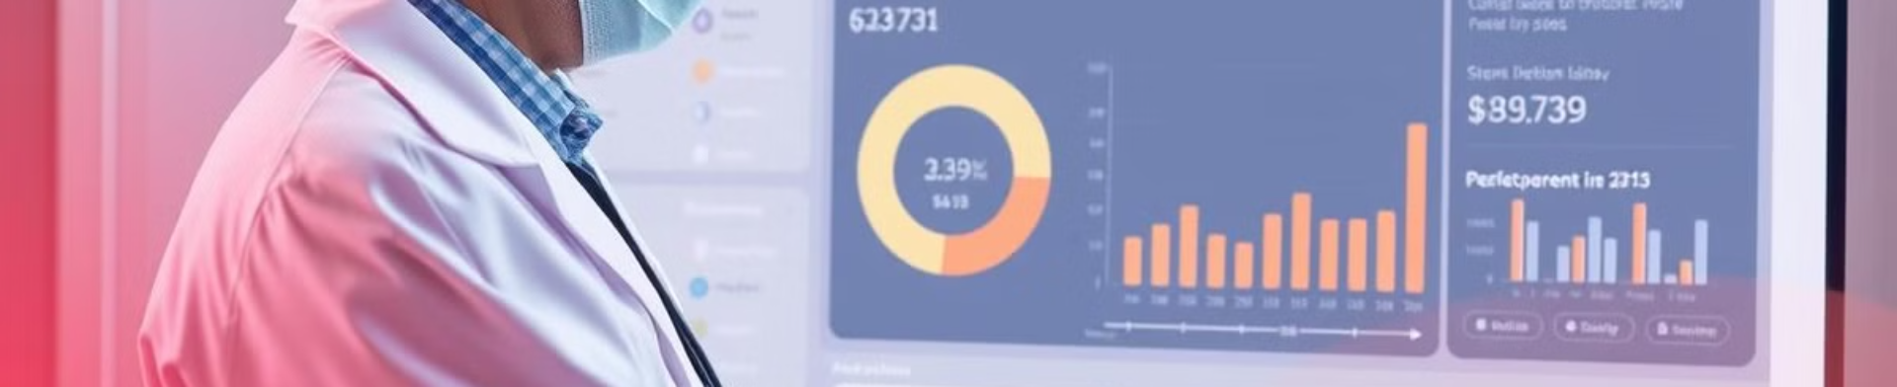



Deployment and User Interface
Clinician Dashboard
Patient Portal
Advanced Analytics
Healthcare providers can access comprehensive patient data and AI-powered insights to support clinical decision-making.
Patients can actively engage with the system, monitor their health, and receive personalized recommendations.
Robust data analytics and visualization tools enable deeper understanding of diabetes trends and risk factors.

Slide 8

Conclusion and Future Directions
Empowering Patients and Providers
Continuous Innovation
We are committed to ongoing research and development to further enhance the system's capabilities and impact.
Our Diabetes Prediction System empowers patients and healthcare providers to take proactive steps towards better health outcomes.
Collaborative Approach
By fostering partnerships with healthcare organizations and researchers, we aim to drive meaningful advancements in diabetes care.

